Slide 1
MONTE CARLO SIMULATIONS FOR INSTANTONS
Marco Uguccioni Master’s Degree in Theoretical Physics, UNIBO
Theoretical and Numerical Aspects of Nuclear Physics 2020/2021 Prof. Finelli

Slide 2
AIM OF THE WORK
Understand the role of Instantons (tunneling events) in QM with Monte Carlo simulations using the double well potential model.
Procedure:
«Exact» numerical diagonalization of the Schroedinger problem as a reference for a comparison with Monte Carlo results.
Solution of the problem on a 1D Euclidean lattice with Path Integral Monte Carlo techniques.
Computation of the Free Energy/Partition Function with Adiabatic Switching technique.
Extraction of the Instanton content (i.e. tunneling rate) of the theory with Cooling method.
Comparison with Random Gas Model and Heating method.

Slide 3
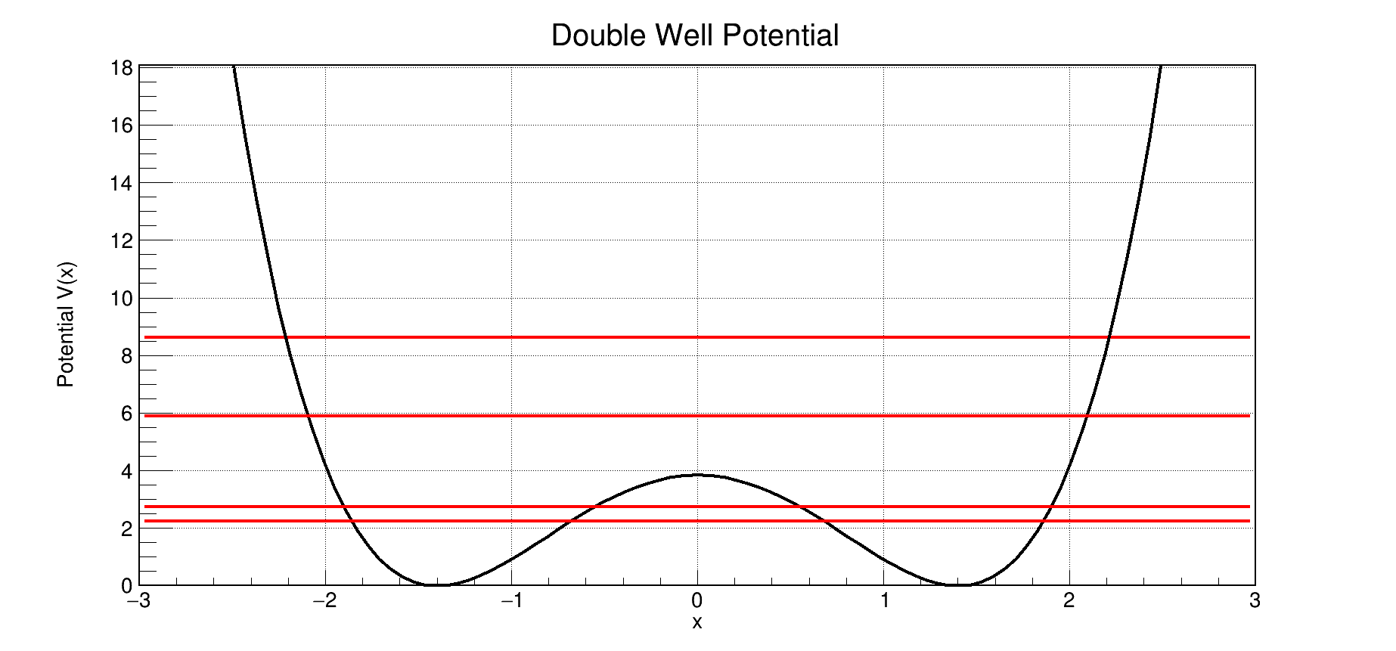
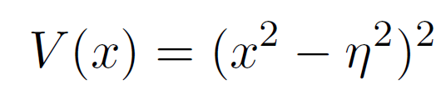
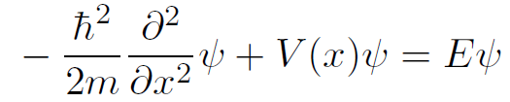
INTRODUCTION
INSTANTON (or PSEUDOPARTICLE): classical solution to Euler-Lagrange equations of motion in Euclidean spacetime with a finite, non-zero action. Used to study tunneling behaviour in various systems.
DOUBLE WELL POTENTIAL: two classical minima, one quantum ground state.

Slide 4
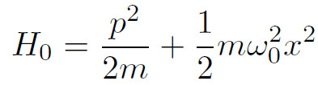
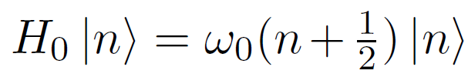











EXACT DIAGONALIZATION (I)
Choice of a reference basis: Harmonic Oscillator
Diagonalize the hamiltonian H in this basis. The only non-zero elements are
Program «exact.cpp» computes:
Energy spectrum
Ground state wave function
Euclidean correlation functions
Partition function

Slide 5
EXACT DIAGONALIZATION (II)
INPUT:
N=40,
η=1.4,
ω₀=4η
Evaluate H.O. wave functions and matrix elements
<0|x^{p}|n>
p=1,2,3
Compute the ground state wave function, correlators, partition function
Diagonalization with Jacobi method (real symmetric matrix)
OUTPUT:
E_{n}, |ψ(x)|²,
< x^{p}(0) x^{p}(τ)>,
Z(β)
Build matrix elements <n|H|m>

Slide 6

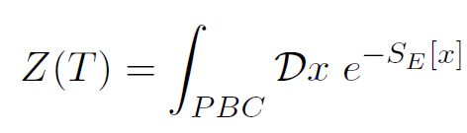
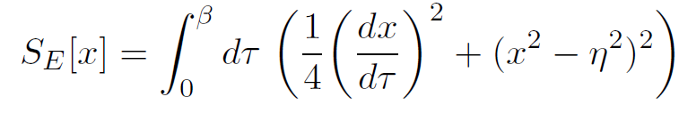
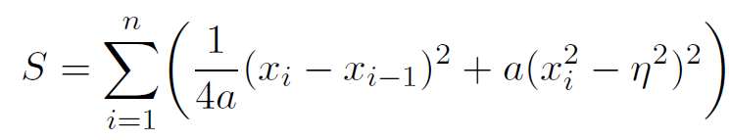


QM ON EUCLIDEAN LATTICE (I)
Path Integral approach + Wick Rotation and periodic B.C.
To study numerical simulations we consider the discretized action such that the P.I. is equivalent to a statistical system of «spins» x_{i} on a lattice with spacing a.
Study the system with Monte Carlo samplings, Metropolis Algorithm: ensemble of configurations generated by trial updates for every lattice point with an acceptance probability

Slide 7
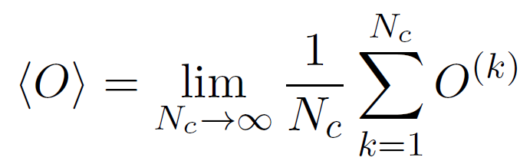
QM ON EUCLIDEAN LATTICE (II)
Quantum mechanical observables become simply an average over a large number of configurations N_{c}
Comparison between two initial configurations hot (random) and cold (aligned spins) after a sufficient number of equilibriation sweeps.
Program «montecarlo.cpp» computes:
Action for each configuration Euclidean 2-points correlation functions for x,x²,x³ Normalized distribution of x

Slide 8
QM ON EUCLIDEAN LATTICE (III)
INPUT:
η=1.4, n=800
a=0.05, hot=(1,0),
N_{c}=10⁵, δx=0.5
Initialize first configuration (hot or cold)
+ PBC
Monte Carlo loop over configurations
Accept
x_{i}(k+1) = x_{i}(k) + rnd(-1,1)*δx
(N_{acc} +1)
Loop for each configuration over lattice sites
(N_{hit} +1)
T
exp(-ΔS)>rnd(0,1)
F
Compute action, correlators and populate the distribution of x
OUTPUT:
S, x_{i}(k),
<x^{p}(0)x^{p}(τ)>,
x distribution

Slide 9
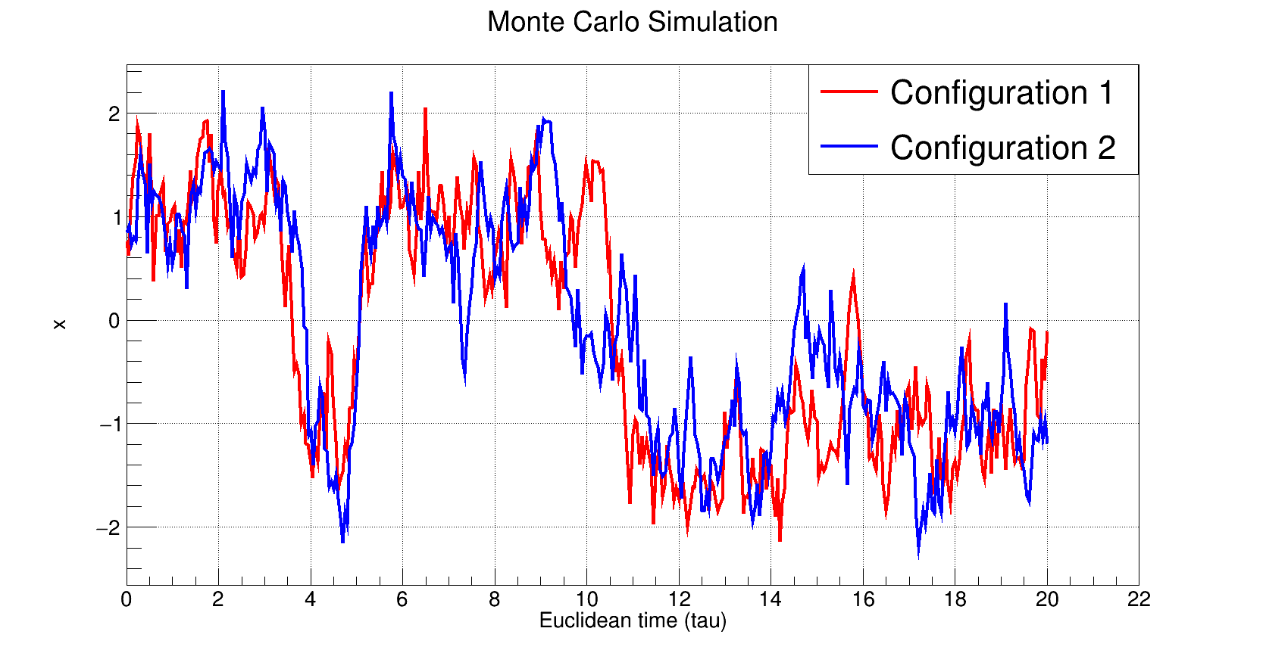




NUMERICAL RESULTS (I)
Typical cold and hot paths after equilibration.
Two time scales:
Reliable simulations with:

Slide 10
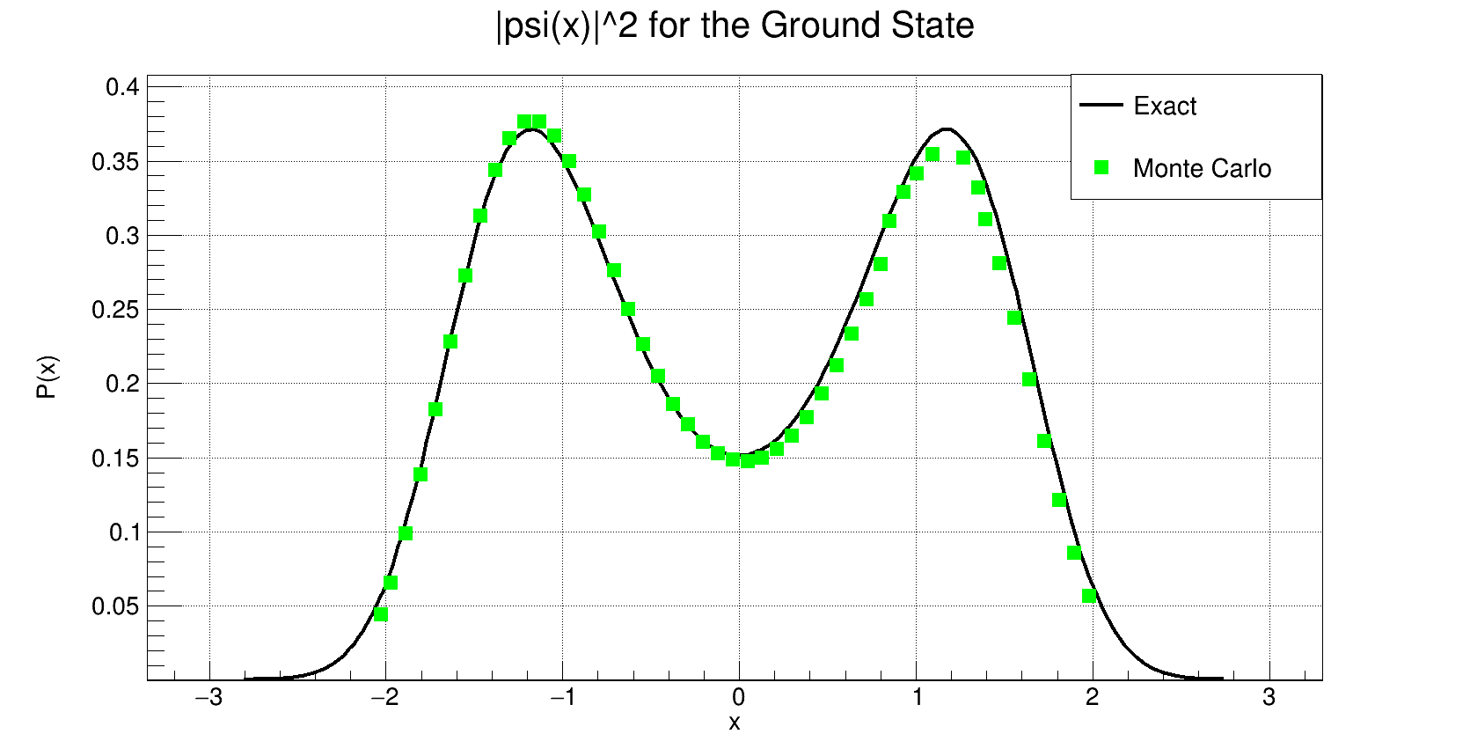
NUMERICAL RESULTS (II)
Probability to find the particle is maximal in the two wells, as expected.

Slide 11
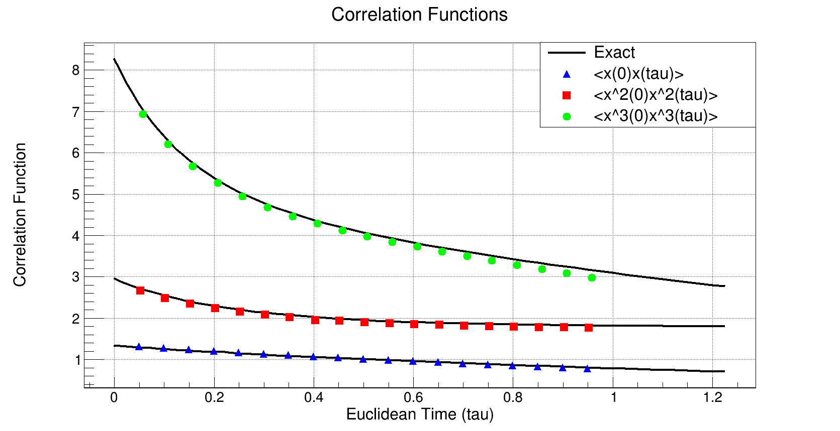
NUMERICAL RESULTS (III)
Excellent agreement. The correlation functions are measured using n_{p}=20 points in the lattice and n_{c}=5 measurement for each configuration.

Slide 12


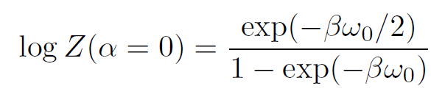



ADIABATIC SWITCHING (I)
Monte Carlo does not directly give the partition function or the free energy of the system, but we can use the adiabatic switching technique.
Use a reference system for which the free energy is known and introduce a coupling costant α such that
As a reference system we use the H.O.
Integral over coupling constant can be calculated in Monte Carlo simulations by slowly changing α from 0 to 1.
Presence of possible hysteresis effects (systematic errors) due to incomplete equilibration: repeat the calculation from 1 to 0.
Program «adiabatic.cpp» compute the free energy

Slide 13
ADIABATIC SWITCHING (II)
INPUT:
η=1.4, n, a, hot=(1,0), N_{c}=10⁴, δx=0.5,
ω₀=4η, n_{α}=20
Initialize first configuration (hot or cold)
+ PBC
Loop over coupling constant α + hysteresis effects
Loop for each configuration over lattice sites
(N_{hit} +1)
Monte Carlo loop over configurations
exp(-ΔS_{α})>rnd(0,1)
T
F
Accept
x_{i}(k+1) = x_{i}(k) + rnd(-1,1)*δx
(N_{acc} +1)
Compute integral over coupling α and the free energy in function of α
OUTPUT:
S_{α}, F(T, α),
F(T)=-logZ(T)

Slide 14
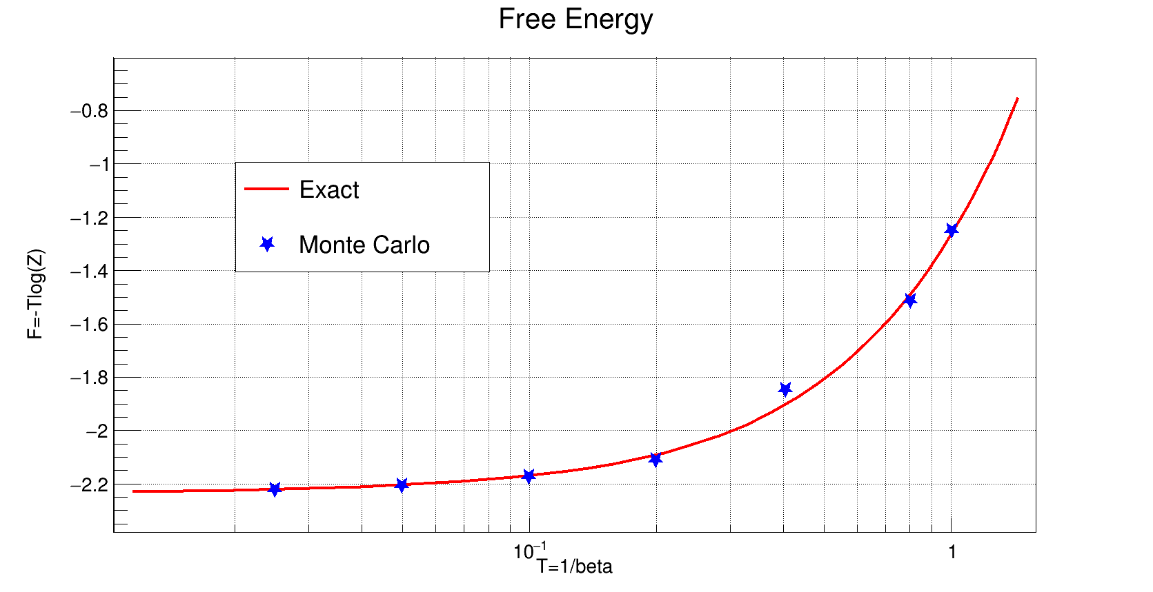
NUMERICAL RESULTS (IV)
Data points obtained executing the program for different values of temperature T.
Monte Carlo results agree, but the method is limited to low temperatures.

Slide 15

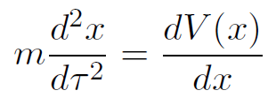



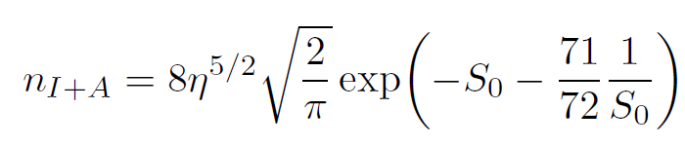

INSTANTON CONTENT
Instanton solution can be found from the classical Euclidean equation of motions with boundary conditions where τ₀ can be interpreted as the «location» of the instanton.
Instanton density or tunneling rate can be computed exactly next-to-leading order in the semiclassical approximation (correct if we consider S₀~3).

Slide 16
COOLING METHOD (I)
Method used to remove short distance fluctuations. We only accept Metropolis updates that lower the action. This drives the system towards the nearest classical solution and allows to study the instanton content of a quantum configuration.
Allows to extract of the instanton/anti-instanton number and locations from the zero-crossings in the Euclidean path.
We lose agreement with the exact value of the correlation functions, since we are removing fluctuations which are fundamental to analyze correlations.
Program «cooling.cpp» computes: Cooled Euclidean 2-points correlation functions for x,x²,x³ Instanton density in function of the cooling sweeps

Slide 17
COOLING METHOD (II)
INPUT:
η=1.4, n=800
a=0.05, hot=(1,0), N_{c}=10⁴, δx=0.5, n_{cool}=100
Accept
x_{i}(k+1) = x_{i}(k) + rnd(-1,1)*δx
(N_{acc} +1)
T
Accept values that lower the action
x_{i}^{cool} (k+1)=x_{i}(k+1)
S(x(k+1))<S(x(k))
F
T
Initialize first configuration (hot or cold)
+ PBC
F
Compute correlators and instanton number from zero-crossings
exp(-ΔS)>rnd(0,1)
Loop for each configuration over lattice sites
(N_{hit} +1)
Monte Carlo loop over configurations
OUTPUT:
x_{i}(k), x_{i}^{cool}(k), N_{I+A}
<x^{p}_{cool}(0)x^{p}_{cool}(τ)>,

Slide 18
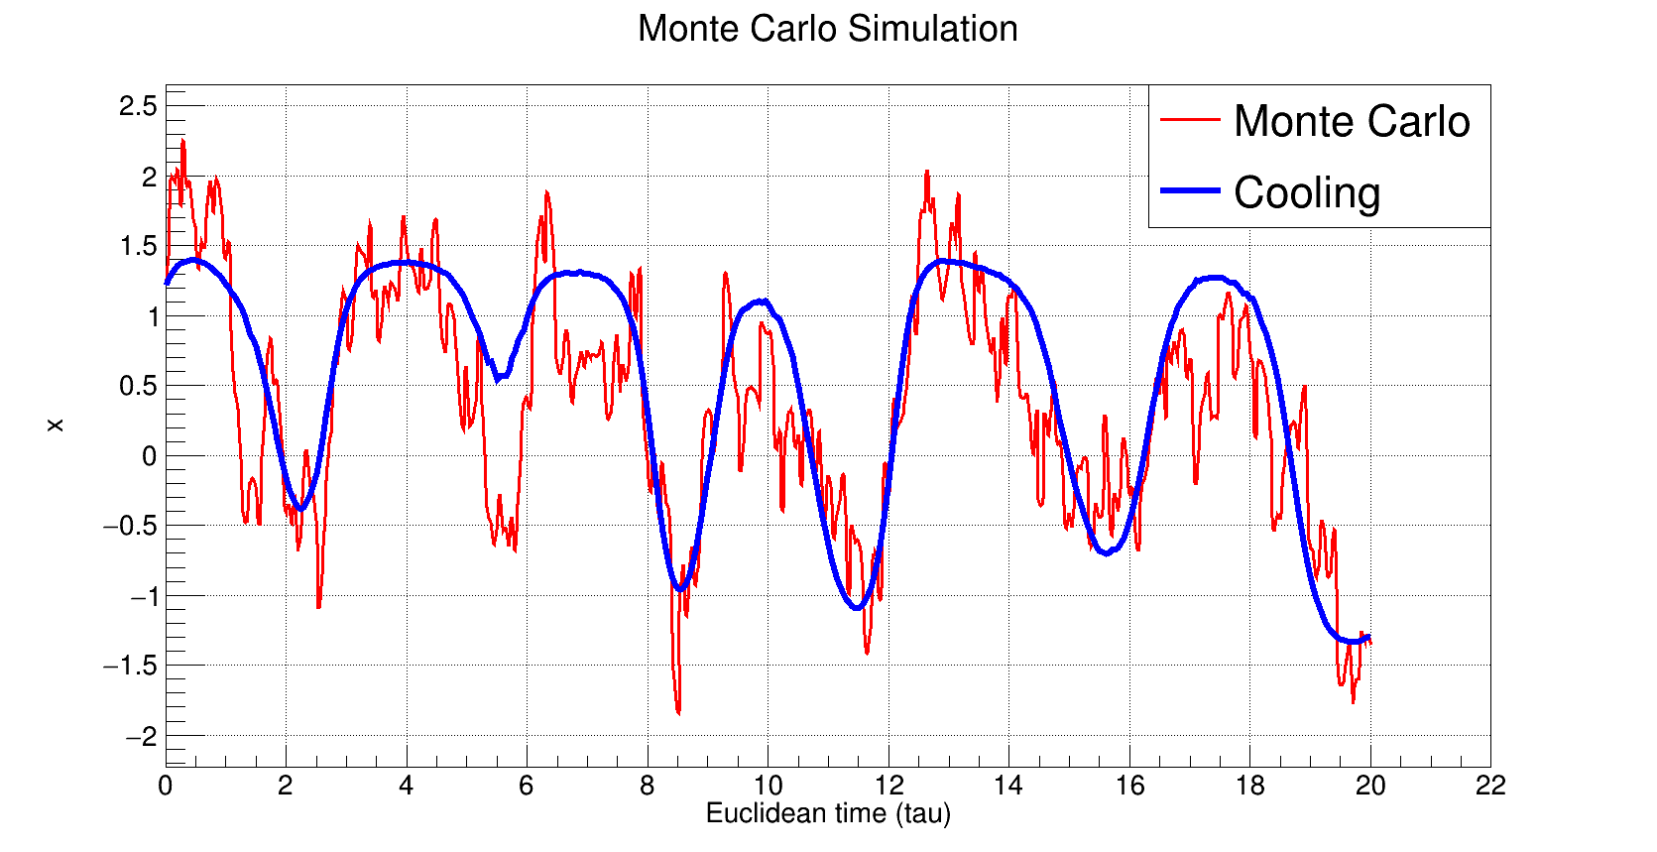
NUMERICAL RESULTS (V)
Cooled Euclidean path obtained by running 100 cooling sweeps on the original path.

Slide 19
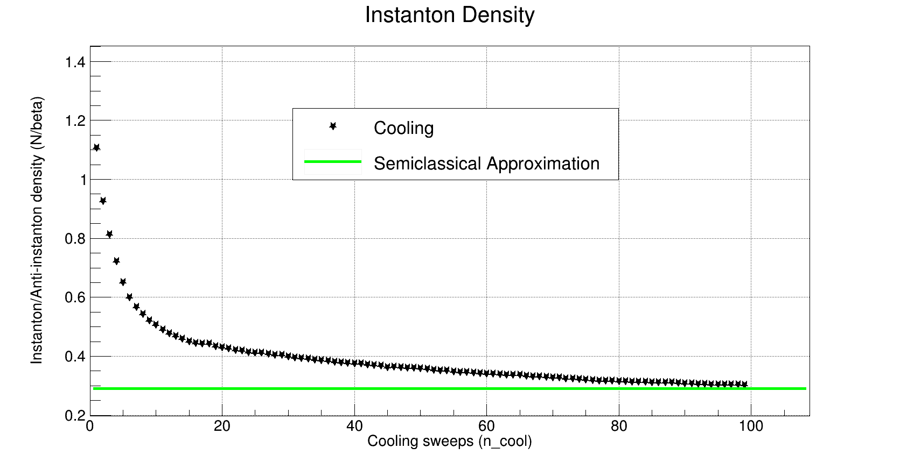
NUMERICAL RESULTS (VI)
Instanton + Anti-instanton density in function of the cooling sweeps. For η=1.4 it’s possible to notice a convergence to the semiclassical value, as expected.

Slide 20
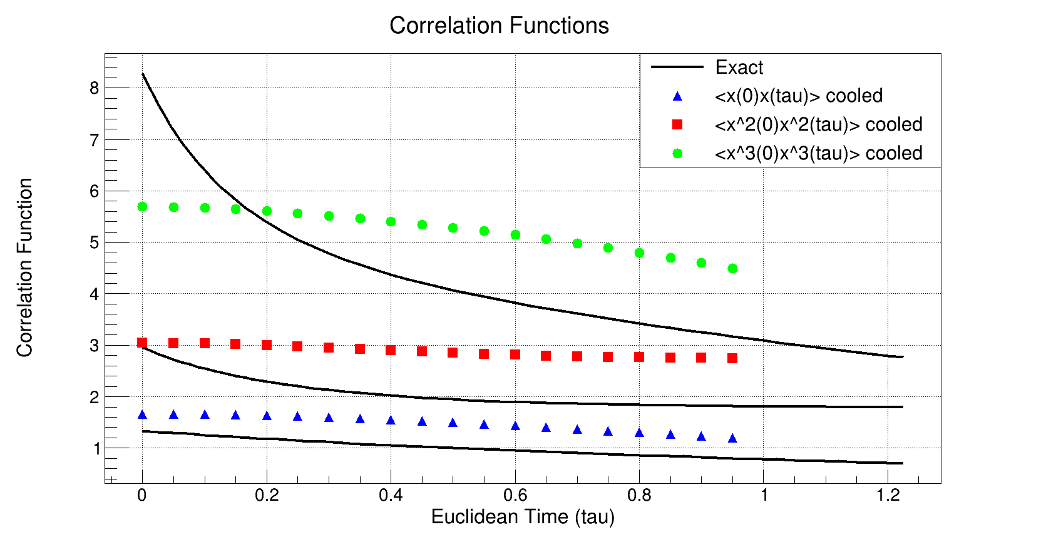
NUMERICAL RESULTS (VII)
Cooled correlation functions are clearly not in agreement with the exact solution.

Slide 21



INSTANTON RANDOM GAS
Random Instanton Gas model: ignore interactions and consider a random distribution of collective instanton locations τ_{i}.
Simplest path for a multi-instanton configuration is a superposition of indipendent tunneling events with different topological charges Q_{i}
Random gas model does not give a good description of correlation functions since quantum fluctuations are missing, like in the cooling method.

Slide 22

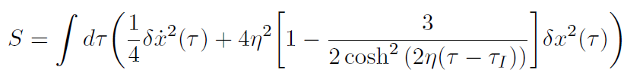
HEATING METHOD (I)
Inverse of the cooling method: allows to get correlation functions numerically starting from a classical ensemble of instantons.
To develop heating introduce Gaussian fluctuations:
Perform Monte Carlo calculations using the Gaussian action, starting with the instanton random gas model.
Program «heating.cpp» computes the heated Euclidean 2-points correlation functions for x,x²,x³

Slide 23
HEATING METHOD (II)
INPUT:
η=1.4, n=800, N_{I+A}
a=0.05, N_{c}=10⁴,
δx=0.5, n_{heat}=10
Set the instanton locations (random) and the
multi-instanton configuration
Monte Carlo loop over configurations
Loop for each configuration and heating sweep over lattice sites
(N_{hit} +1)
exp(-ΔS)>rnd(0,1)
S_{Gauss}
Loop over the heating sweeps
T
F
Accept
x_{i}^{hot}(k+1) = x_{i}^{hot}(k)
+ rnd(-1,1)*δx
(N_{acc} +1)
OUTPUT:
x_{i}(k), x_{i}^{hot}(k),
<x^{p}_{hot}(0)x^{p}_{hot}(τ)>,
Compute heated correlation functions

Slide 24
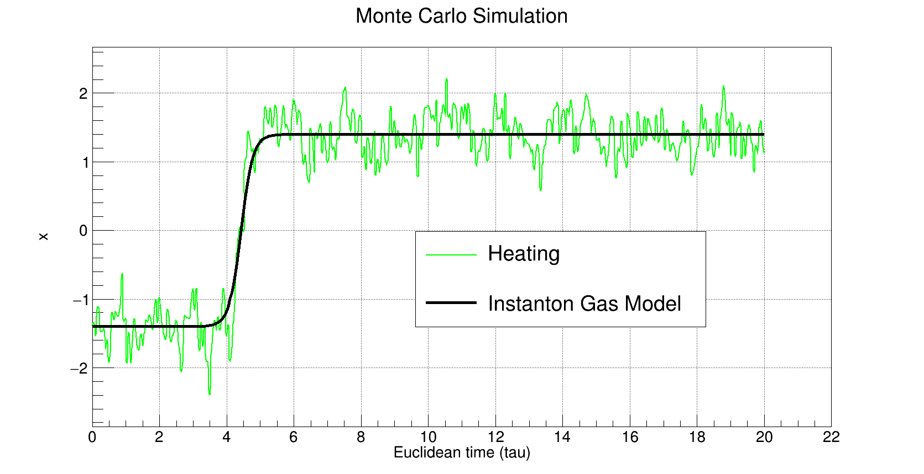
NUMERICAL RESULTS (VIII)
Random instanton configuration and the same with Gaussian fluctuations (heating).
The noise is generated using 10 heating sweeps.

Slide 25
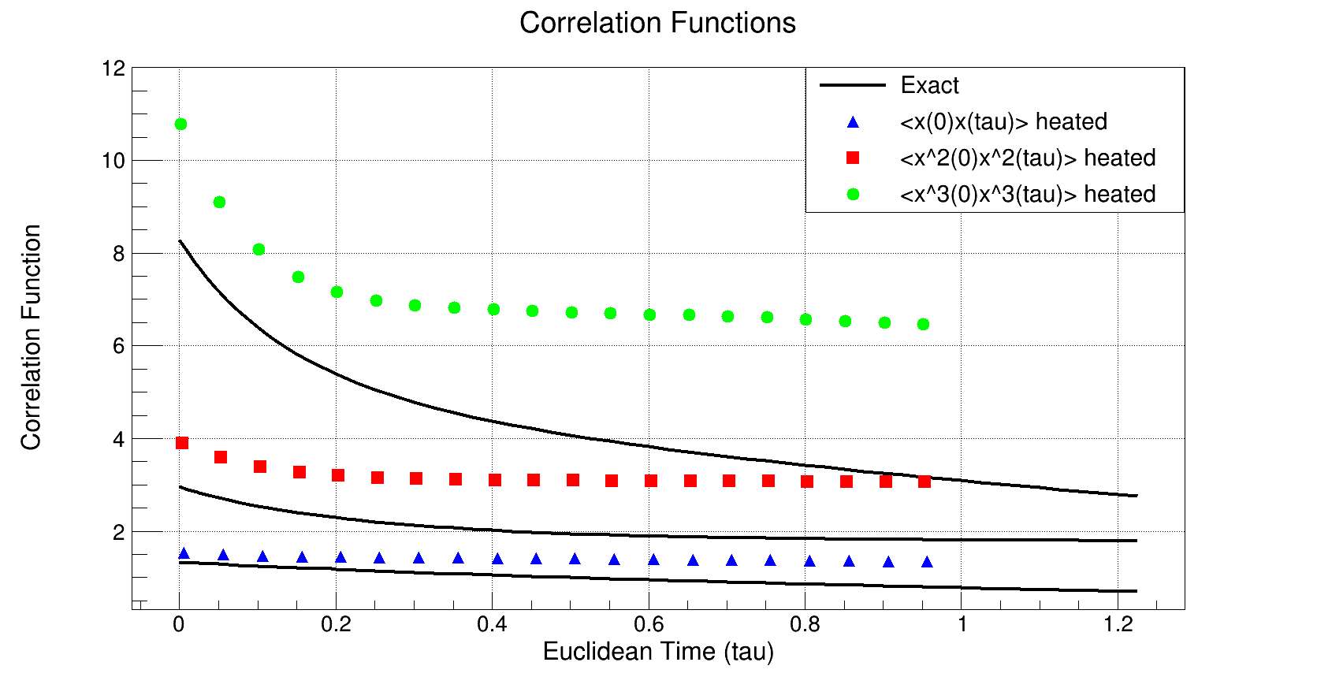
NUMERICAL RESULTS (IX)
Heated correlation functions are better than the correlators obtained from the cooling method, but still not in agreement with the exact solution.

Slide 26
CONCLUSIONS
The exact diagonalization program is both much faster and accurate than the Monte Carlo codes. However hamiltonian methods become impractical when we increase the degrees of freedom of the system, so Monte Carlo becomes fundamental.
Cooling method useful to get the instanton content of the theory (double-well) but we lose informations on the correlation functions.
Heating method useful to get correlation functions numerically, starting from a classical ensemble of instantons. However the assumption of instanton random gas is not fully correct.
A better result is obtained with the Instanton Liquid Model, including interactions among instantons and non-Gaussian effects.

Slide 27
THANKS FOR YOUR ATTENTION!

